Slide 1
Online Vegetable Store
Presented By:
CH Vidhya
T Surekha
TH Gopala Krishna
T Veera Rakesh Reddy
Shaik Sumer Basha
N Deepa

Slide 2
ABSTRACT
Online Vegetables store is a project developed to make the purchase of vegetables in a easy way. This application makes the need of the sales and purchase of vegetables safe and good quality. This application will reduce the manual operation required to maintain all the records of sales and purchase. This system allows to search number of items. Different types of vegetables items will be available to the users in this application.

Slide 3
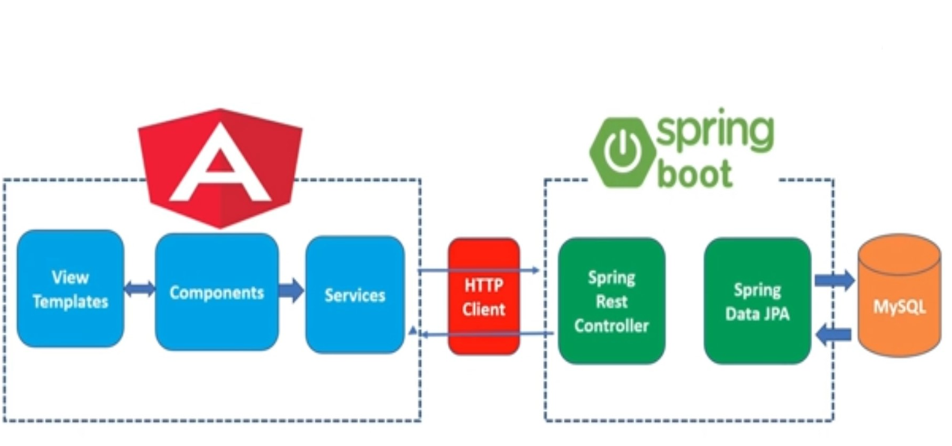
FRONT-END BACK-END

Slide 4
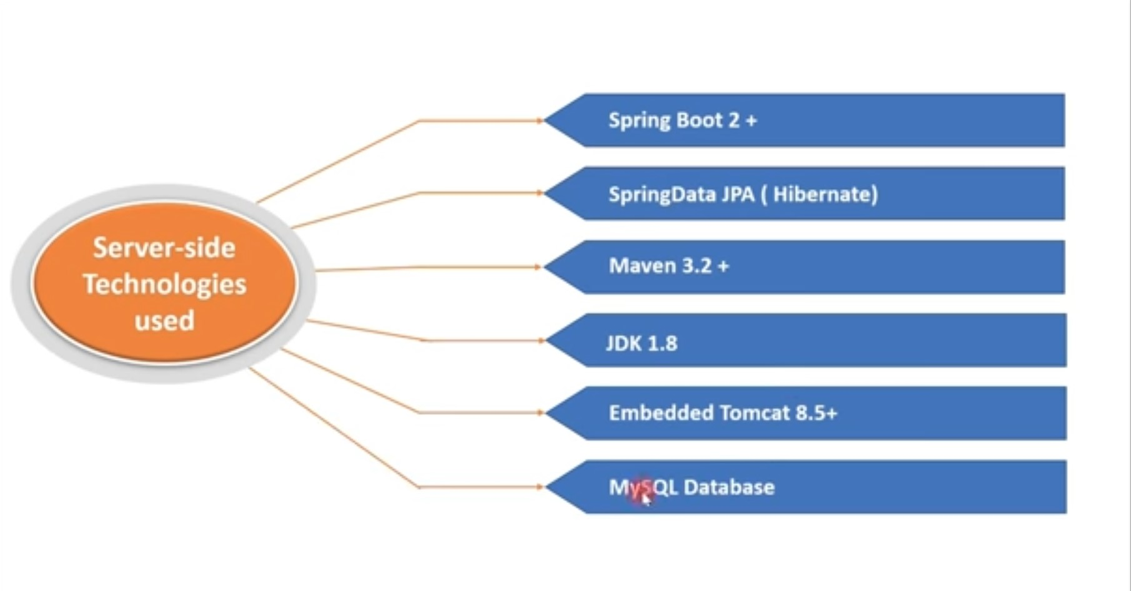
BACK-END TECHNOLOGIES

Slide 5
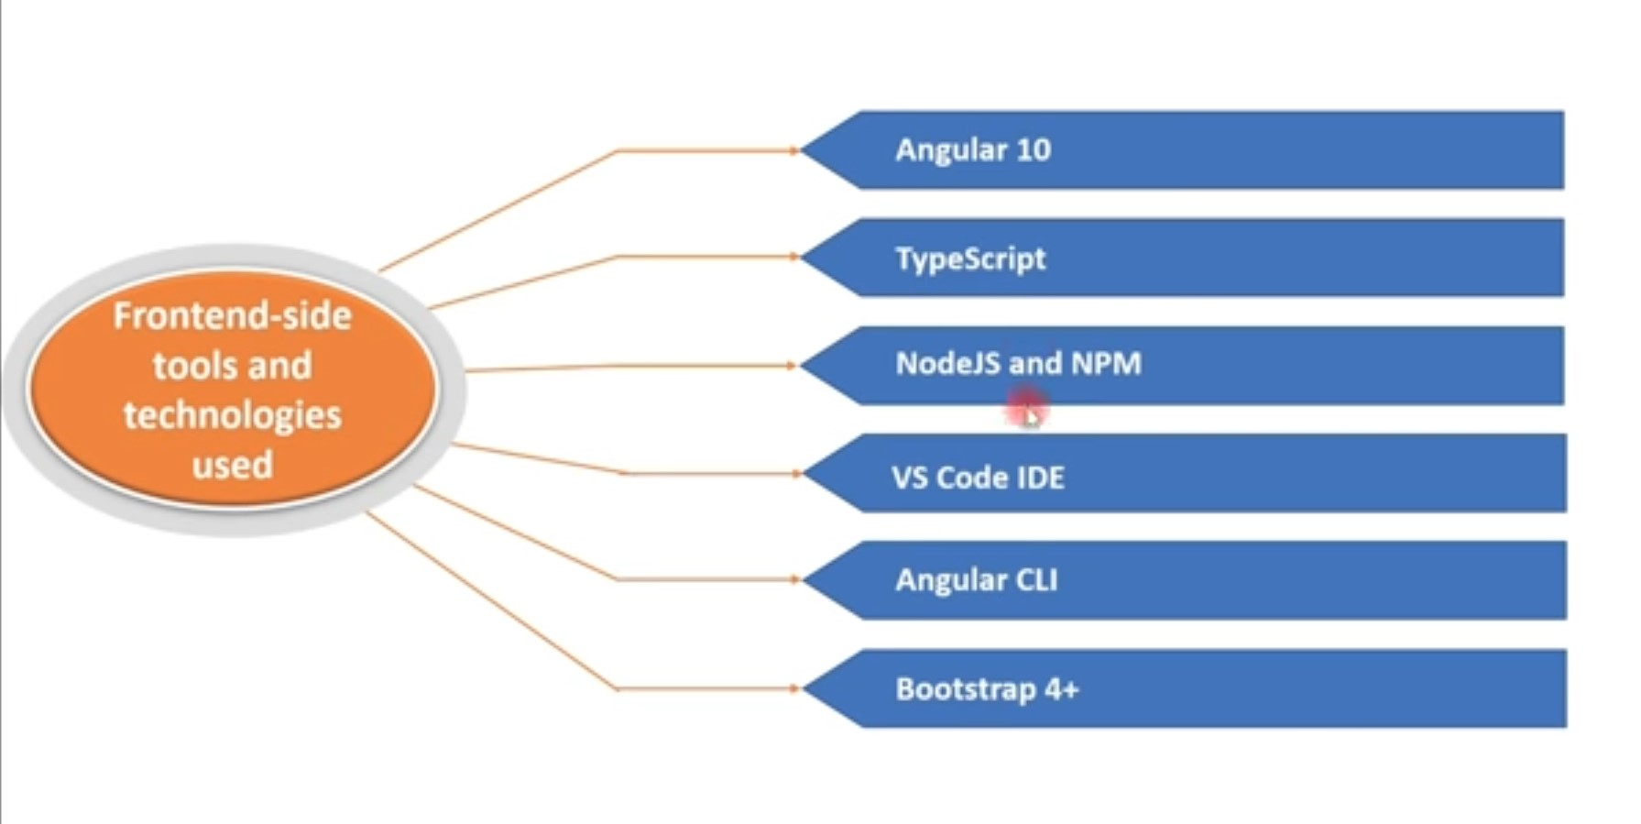
FRONT-END TECHNOLOGIES

Slide 6
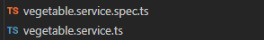
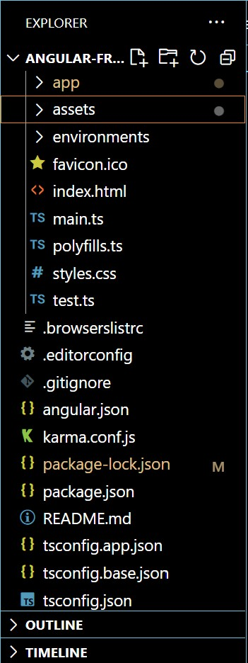
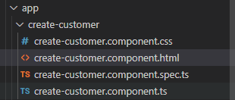
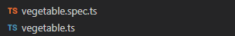
Creating a Service syntax:-ng g s customer
Creating a new Application​ syntax:-ng new online_veg_front_end_Master
Creating a component​ syntax:-ng g c customer
Creating a class​ syntax:-ng g cl vegetable

Slide 7
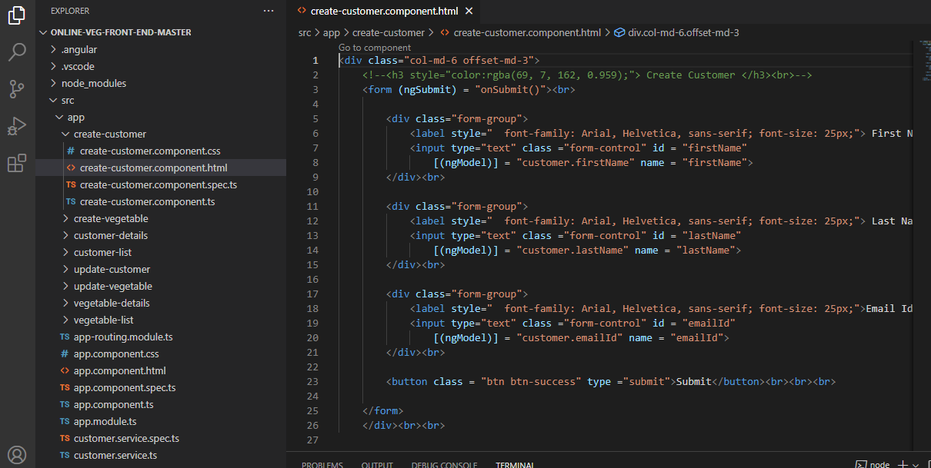
Online Vegetable Store Front end

Slide 8
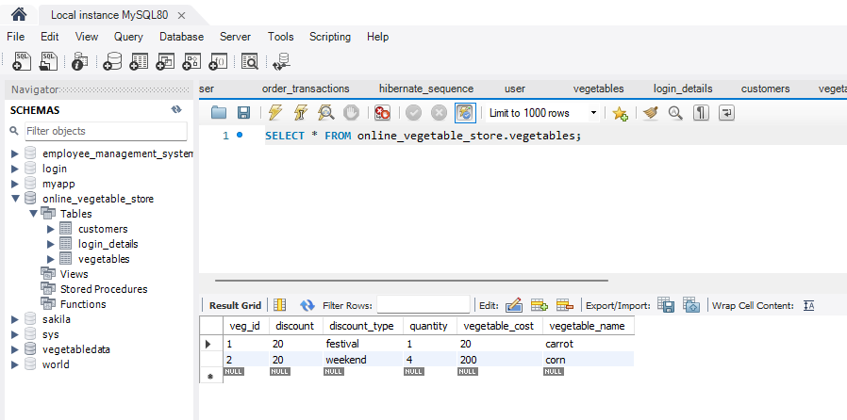

Slide 9
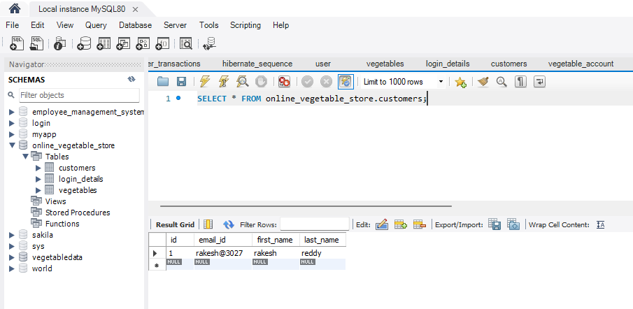

Slide 10
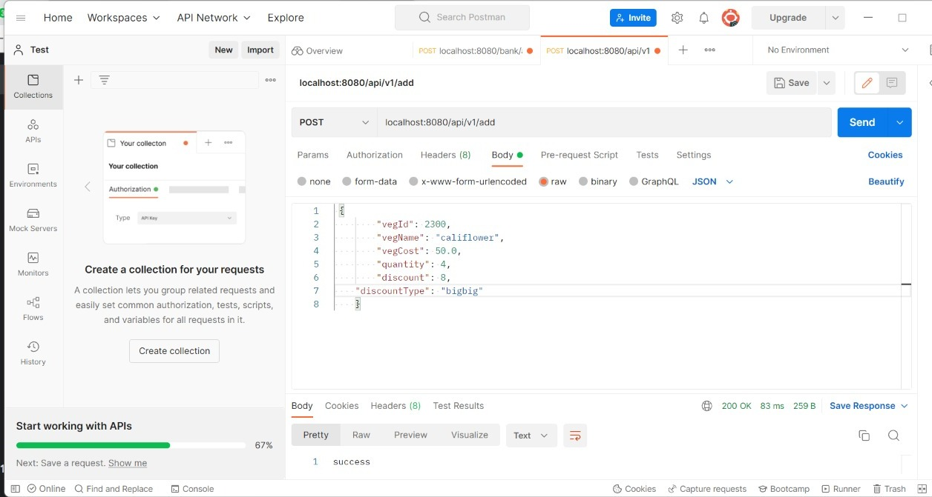
Post vegetable through postman

Slide 11
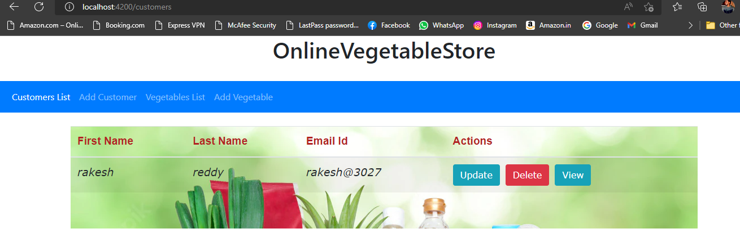

Slide 12
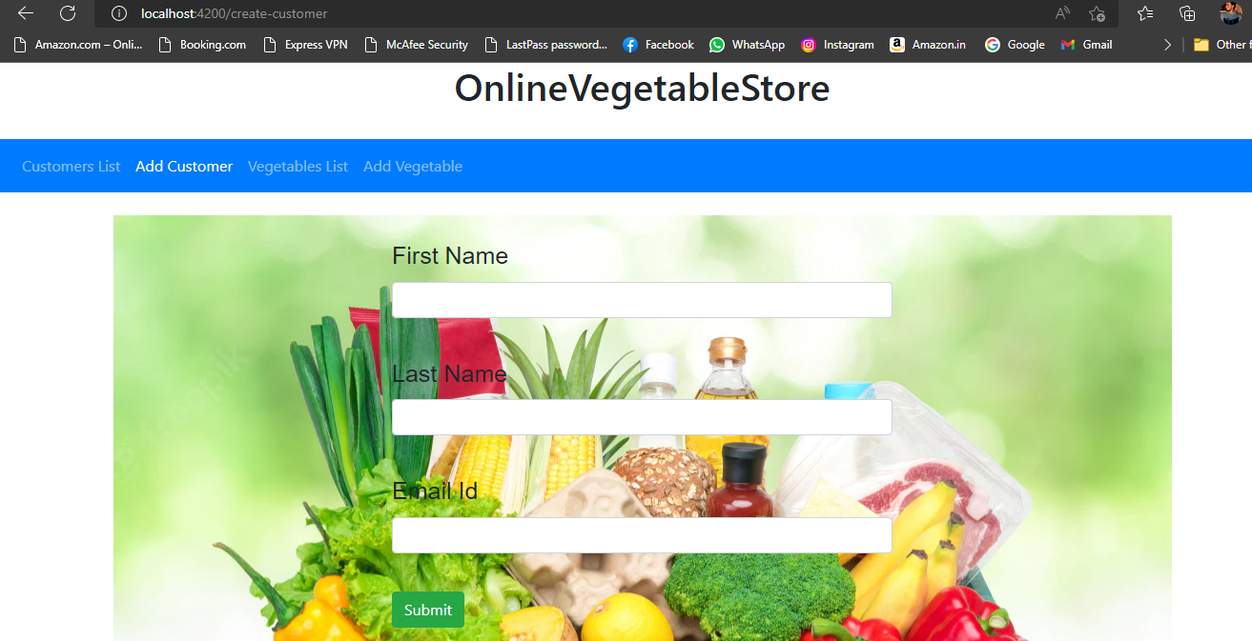

Slide 13
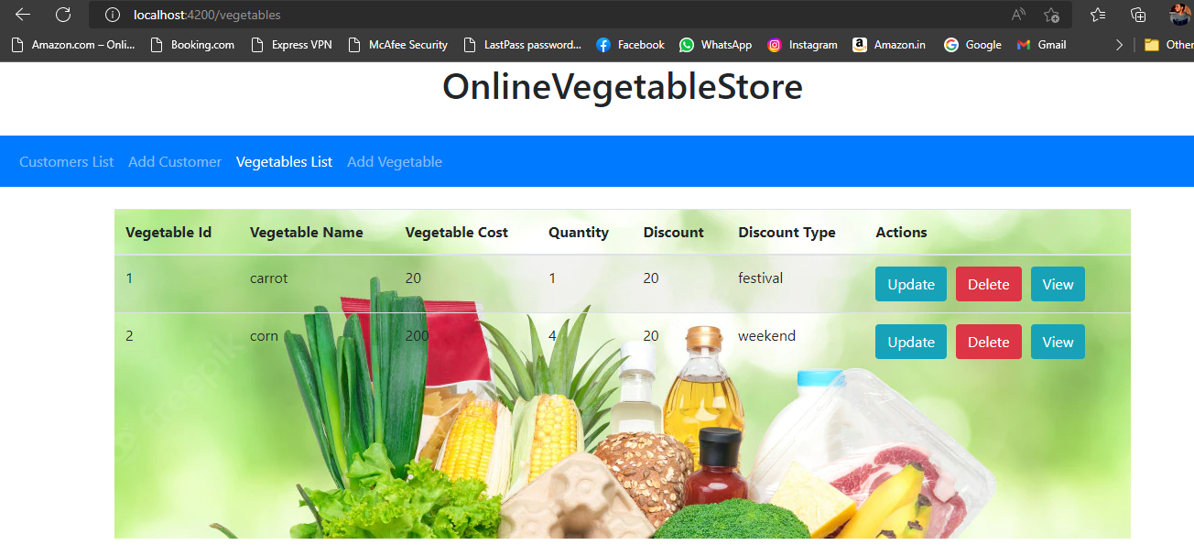

Slide 14
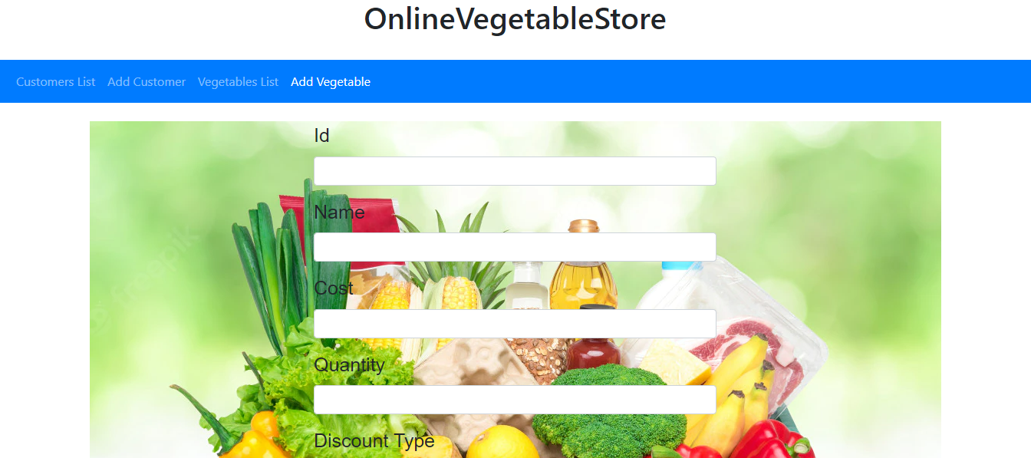

Slide 15
End user
User: log in/log out
Can search for vegetables Categories.
Can search for a specific sports using their name.
Users can place/cancel an order.
Can change password.
Can Manage “My profile”.

Slide 16
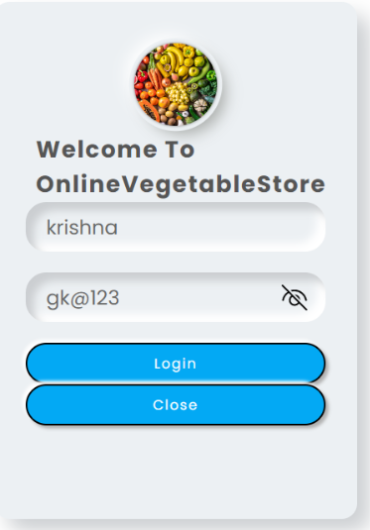
Login pAge

Slide 17
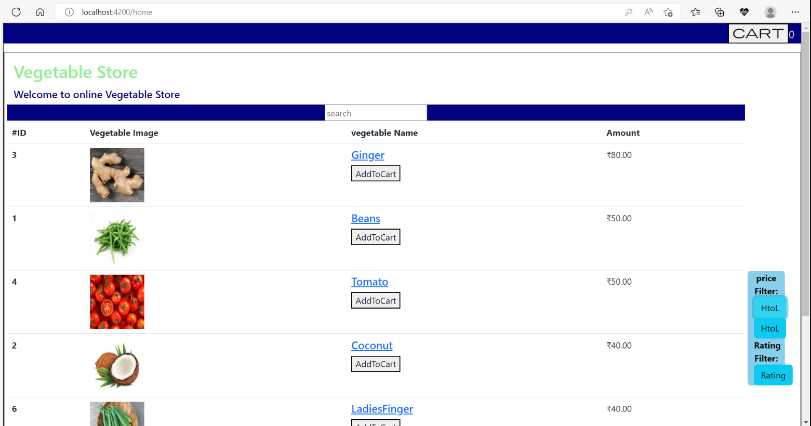

Slide 18
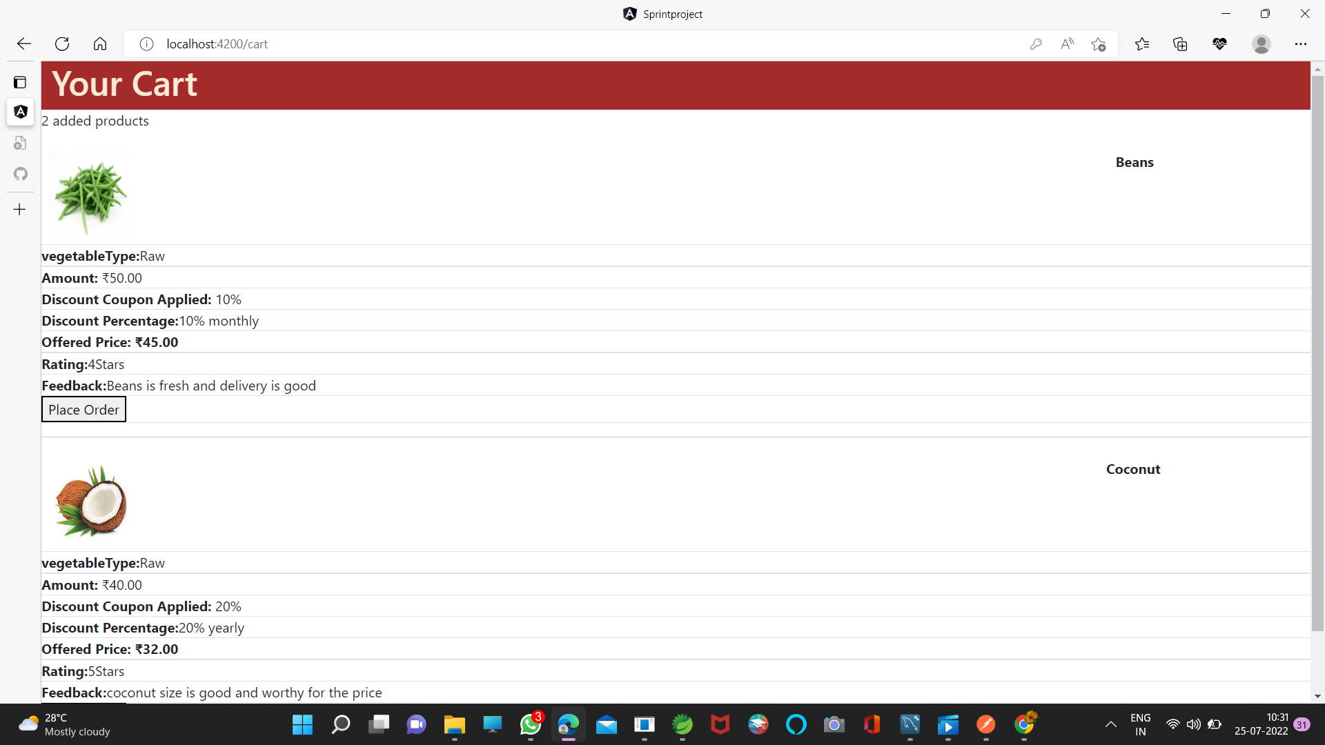

Slide 19
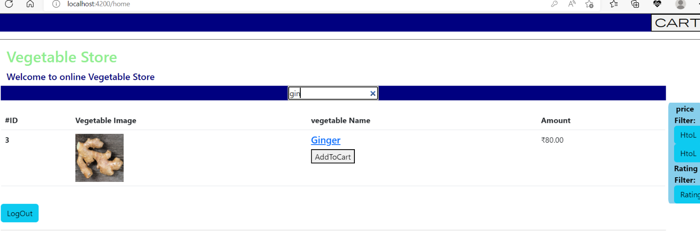

Slide 20


